Slide 2
VidBrief: YouTube Transcript Summarizer
Submitted to: Prof. Mayank Bhatt
Department of Computer Science and Engineering (Data Science)

Slide 3
Supervised by: Prof. Pawan Makhija
Team Members
Aditya Yadav (0827CD211005)
Akash Patel (0827CD211006)
Bhavya Jain (0827CD211018)
Neeraj Sahu (0827CD211040)

Slide 4
Project Presentation Outline
Abstract
Introduction
Problem Statement
Objectives
Survey of existing systems
Requirement Analysis
Solution Proposed
Outcome Discussion
Block Diagram
Hardware Requirements
Software Requirements
Result
Conclusion
Acknowledgement
References

Slide 5
Abstract
This project revolves around summarizing the text contained in the transcript of YouTube videos such as lectures, meetings, speeches, etc to help people extract meaningful information and efficient consumption of the video. Watching lengthy videos to extract key points can be time-consuming and inefficient. A YouTube Transcript Summarizer addresses this issue by automatically generating concise summaries of video transcripts, allowing users to grasp the main ideas without watching the entire video. The goal is to enhance the accessibility of YouTube content by enabling users to quickly understand lengthy videos without watching them in full.

Slide 6
Introduction
The purpose of a YouTube transcript summarizer is to provide users with a concise and easily digestible summary of a video's content without requiring them to watch the entire video or read the full transcript. With the vast amount of video content on YouTube, it can be time-consuming for viewers to sift through long videos to find key information. By summarizing the transcript, the tool helps users quickly understand the main points, topics, or arguments presented in the video. This can be especially useful for educational content, tutorials, lectures, or any informational videos where users want to save time or focus on specific segments. It also improves accessibility for people who prefer reading over watching or those with hearing impairments, offering a text-based way to engage with the content.The purpose of a YouTube transcript summarizer is to help users quickly grasp the main points of a video without having to watch the entire content.

Slide 7
Problem Statement
In today's digital age, YouTube has become a leading platform for hosting vast amounts of video content, including educational tutorials, lectures, webinars, and entertainment. However, with the ever-growing volume of videos, users often face challenges in efficiently extracting and digesting key information from lengthy content. YouTube provides transcripts for many videos, but these can be unstructured, difficult to navigate, and time-consuming to review. Additionally, the quality of auto-generated captions varies greatly, particularly for videos with specialized jargon, accents, or background noise, further complicating the process. Thus, there is a clear need for a solution that automates the extraction and summarization of YouTube transcripts, offering concise, contextually accurate, and customizable summaries to save time and improve content accessibility for a global audience.

Slide 8
Objectives
1. Direct YouTube API Integration: The tool should integrate directly with the YouTube API to automatically fetch video transcripts, eliminating the need for manual input or copy-pasting.
2. Enhanced NLP and AI-based Summarization: The tool will use advanced natural language processing (NLP) techniques, such as transformer models to provide more context-aware and accurate summaries.
3. Caption and Transcript Correction: The tool will integrate a caption correction module that can enhance the quality of auto-generated captions by applying AI-based correction techniques, improving the accuracy of the transcript before summarization.
4. User Interface (UI) and Experience: The tool will develop a clean and intuitive interface where users can simply input a YouTube video URL, select the desired summarization options (length, language, style), and receive the output in seconds.

Slide 9
Survey of Existing Systems
1. HARPA AI: Struggles with accurately summarizing videos with complex or technical content. May miss nuances or context, leading to incomplete summaries.
2. Merlin AI: Can be resource-intensive, especially for long videos. Sometimes generates summaries that are too brief, missing key details.
3. Scrapestorm: Lacks real-time integration with YouTube, making the process tedious, and summarization quality is also inconsistent for longer videos.
4. Eightify: Can sometimes oversimplify content, leading to loss of important information. Also, it may not handle videos in languages other than English effectively.
5. Youtubesummarizer.tech: May struggle with videos that have poor audio quality or heavy accents, leading to inaccurate transcripts and summaries.

Slide 10
Requirement Analysis
Data: Use of correct data for making accurate predictions.
Real-time predictions: The ability to predict in real-time or near real-time.
Accuracy: High accuracy of predictions, based on validated predictions.
User-friendly Interface: An user-friendly designs that allows the users to easily access and interpret the predictions.
Historical data: Access to past results and trends to help users understand the patterns that lead to forest fires.
User Feedback and Support: Access to user support and the ability to provide feedback to improve the accuracy of the predictions.

Slide 11
Solution Proposed
The proposed solution for this project is a web-based application that will allow users to summarize the YouTube video transcipts.
The application will use a variety of libraries and frameworks, such as HTML, CSS, Python, Flask, MySQL, numpy, pandas, scikit-learn, tensorflow and NLP technologies like transformers for creating pipelines for summarization.
The application will also provide a user-friendly interface that will allow users to summarize the video by simply providing the URL of the corresponding video and the rest will be done by the system.

Slide 12
Outcome Discussion
Students and Researchers: A transcript summarizer can help students and researchers quickly review long educational videos, lectures, or webinars by extracting key information. It can condense hours of content into concise summaries, making it easier to study or reference material.
Business Meetings and Webinars: Professionals can use a YouTube transcript summarizer to review recorded meetings, webinars, or training sessions. It enables them to extract key takeaways or action points from long discussions without having to rewatch the entire meeting.
SEO and Metadata Generation: A YouTube summarizer can help content marketers generate SEO-friendly descriptions, tags, and metadata based on the summarized content, improving video discoverability.
Video Browsing: Instead of watching long videos to determine their relevance, users can read brief summaries to decide if the video content is worth watching. This is useful for researchers, professionals, and casual viewers alike who want to maximize their time.

Slide 13
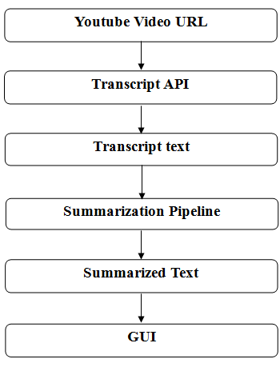
Block Diagram

Slide 14
Hardware Requirements
Processor: At least 1GHz of processing speed.
Memory: At least 1GB of RAM.
Storage: At least 5GB of Hard disk or similar storage device used.
GPU: Any integrated GPU with 128MB of memory or more.
Display: A screen with at least a resolution of 1280x720 pixels.
A stable Internet Connection with at least 1mbps of speed.

Slide 15
Software Requirements
OS: Windows 7, Mac OS 10.x or higher.
Language: Python 3.x .
IDE: Google Colab or Jupyter Notebook.
Browser: latest version of Chrome, Mozilla, Safari or Opera.

Slide 16
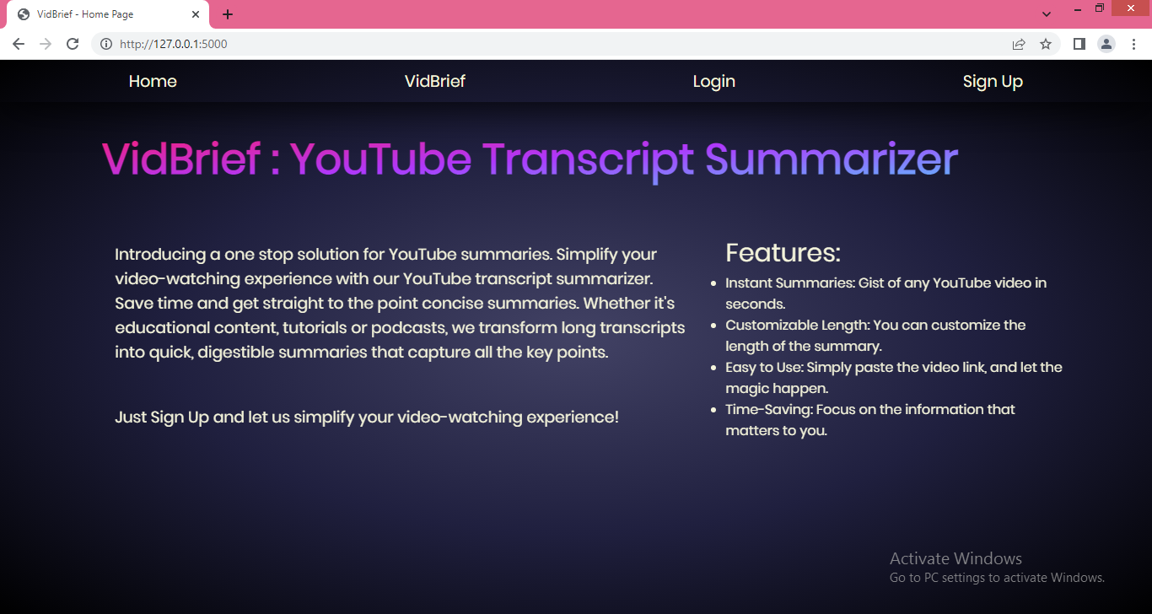
Results
Home page

Slide 17
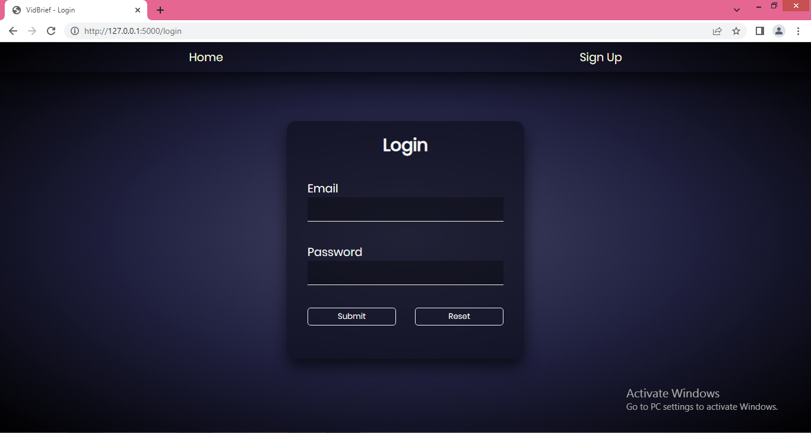
Results
Login page

Slide 18
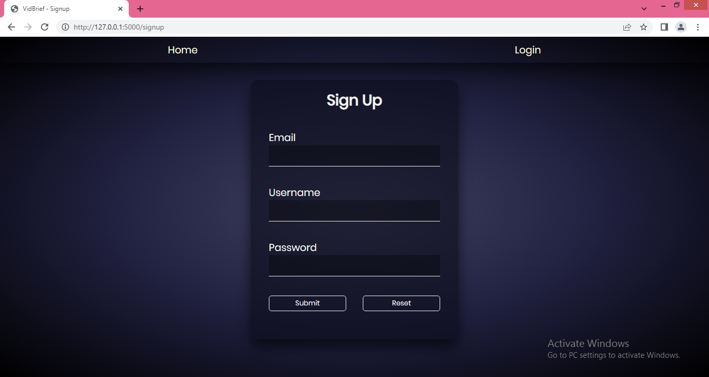
Results
Signup page

Slide 19
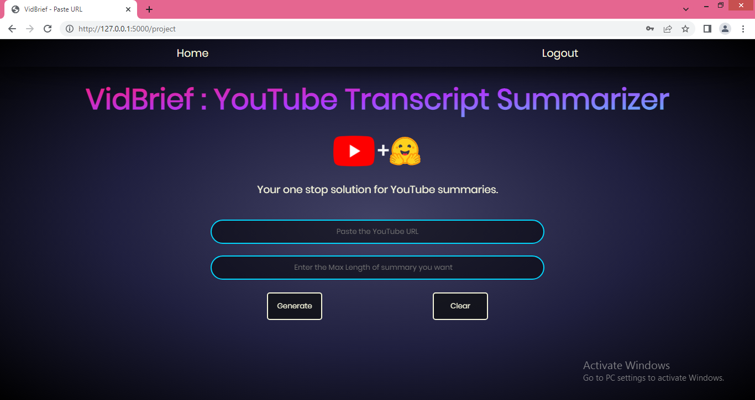
Results
User Input page

Slide 20
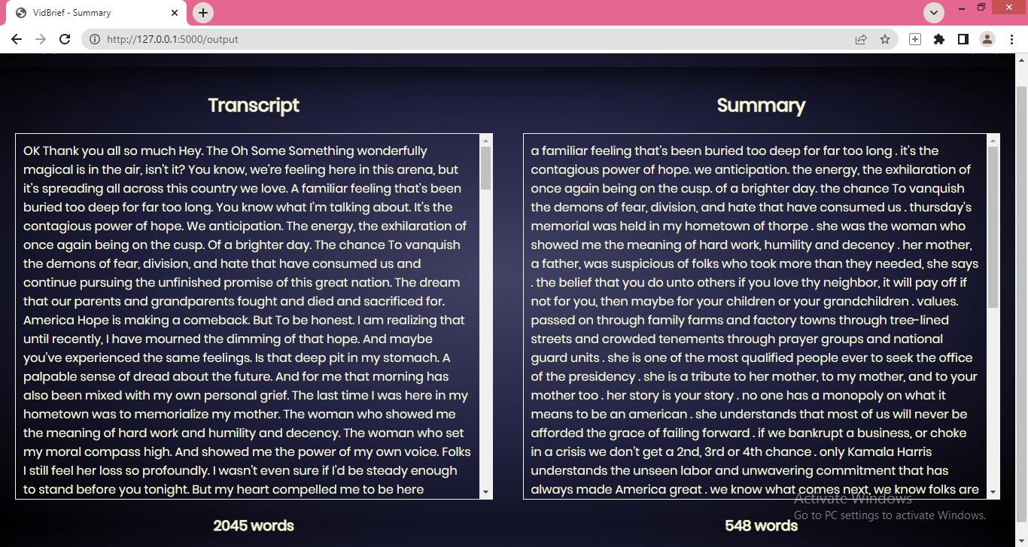
Results
Output page

Slide 21
Conclusion
The project offers substantial benefits for improving accessibility, efficiency, and engagement with video content. By enabling users to quickly access key insights from videos, the summarizer allows for more efficient content consumption, which is especially valuable given the volume of content uploaded daily. This tool supports users with hearing impairments, and individuals with limited time, making YouTube content more inclusive and user-friendly.
For content creators and marketers, the summarizer provides valuable insights into trending topics and viewer preferences, enabling data-driven strategies and more targeted content planning. Additionally, by optimizing content for search engines with concise summaries, the summarizer enhances discoverability, helping creators reach broader audiences.

Slide 22
Acknowledgment
We want to convey our heartfelt gratitude to Prof. Pawan Makhija sir, our mentor, for his invaluable advice and assistance in completing our project. He was there to assist us every step of the way, and his motivation is what enabled us to accomplish our task effectively.
We are also thankful to our Project In-charge Prof. Mayank Bhatt sir, Project Coordinator Prof. Deepak Singh Chauhan sir and Prof. (Dr.) Prashant Lakkadwala, HOD sir for his kind official support and encouragement. Many thanks go to the all lecturers and supervisors who have given their full effort in guiding the team in achieving the goal as well as their encouragement to maintain our progress in track.

Slide 23
References
[1] Jiri Fajtl, Hajar Sadeghi Sokeh, Vasileios Argyriou , Dorothy Monekosso , and PaoloRemagnino: Summarizing Videos with Attention In: Proceedings of the ICLR. Vol. 5(2019).
[2] Kaiyang Zhou, Yu Qiao, Tao Xiang : Deep Reinforcement Learning for UnsupervisedVideo Summarization In: Diversity-Representativeness Reward 2018, Association for theAdvancement of Artificial Intelligence (www.aaai.org).
[3] Mrigank Rochan, Linwei Ye, and Yang Wang: Video Summarization Using FullyConvolutional Sequence Networks In: International Conference on LearningRepresentations (2018).
[4] Ferman A.M. and Tekalp A.M. Two-stage hierarchical video summary extraction tomatch low-level user browsing preerences. IEEE Trans. Multimedia, 5(2):244 – 256, 2003.
[5] P.Sushma, Dr.S.Nagaprasad, Dr. V. Ajantha Devi. Youtube: Bigdata Analytics usingHadoop and Map Reduce in International Journal of Engineering Research in ComputerScience and Engineering (IJERCSE), vol 5, Issue 4, April 2011.
[6] P. R. Dedhia, H. P. Pachgade, A. P. Malani, N. Raul and M. Naik, "Study on Abstractive Text Summarization Techniques," 2020 International Conference on Emerging Trends in Information Technology and Engineering (ic- ETITE), 2020, pp. 1-8, doi: 10.1109/ic-ETITE47903.2020.087.

Slide 24
References
[7] A. Dilawari and M. U. G. Khan, "ASoVS: Abstractive Summarization of Video Sequences," in IEEE Access, vol. 7, pp. 29253-29263, 2019, doi: 10.1109/ACCESS.2019.2902507.
[8] https://medium.com/swlh/parsing-rest-api-payload-and-query-parameters-with-flask-better-than-marshmallow-aa79c889e3ca
[9] https://www.crio.do/projects/python-youtube-transcript/
[10] https://pypi.org/project/youtube-transcript-api/
[11] https://www.thepythoncode.com/article/text-summarization-using-huggingface-transformers- python
[12] https://blog.miguelgrinberg.com/post/designing-a-restful-api-with-python-and-flask

Slide 25
THANKS

